Slide 1

Selection Phase Project Synopsis Presentation
OCTOBER 2023
Dayananda Sagar College of Engineering, Bangalore, Karnataka
Department of Electronics & Communication Engineering
Project Batch No. : B-35
Subject code : 19EC7ICPR1
HeartSage: An Advanced ML Predictive Analytics System for Cardiovascular Health
USN : 1DS20EC116 (Sec-B) Name : NEERAJ JAIN
USN : 1DS20EC197 (Sec-D) Name : SMARAK MISHRA
USN : 1DS20EC214 (Sec-D) Name : SURYANSH DEVASTHALI
USN : 1DS20EC215 (Sec-D) Name : SURYANSH SAHA
Project Team.
Dr. Abhishek M B.
Dr Suma M R- A section,
Prof Srividya L - B section,
Prof Manasa R K- C Section,
Prof Bindu H M - D section.
Dr. Suma M R
Asst. Professor

Slide 2
Overview of the project selection phase presentation
Introduction
Literature Survey
Problem Statement
Objectives
Proposed Methodology with Block Diagrams
Implementation process (h/w - s/w)
Expected results (experimentation, simulation)
Advantages / Applications
Flow of the future works (Nov’23 – Jun’24)
References.

Slide 3

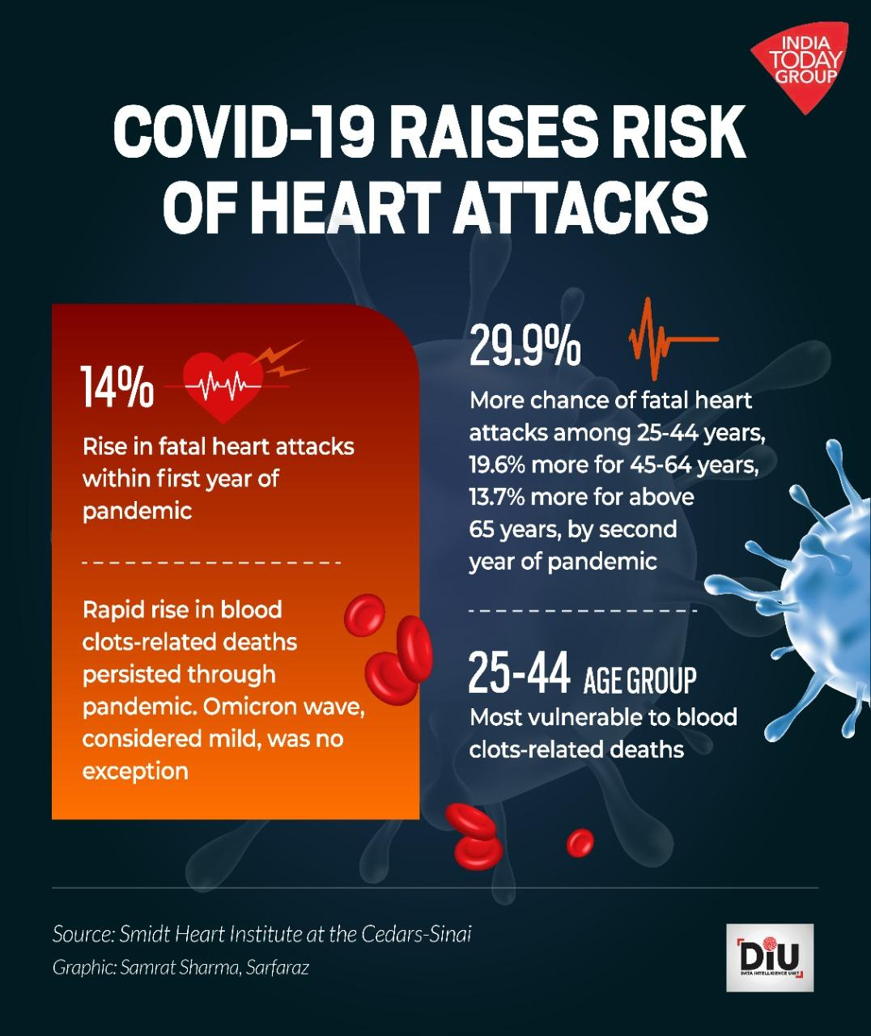
Introduction
An advanced and efficient predictive analytics system for cardiovascular health is crucial in today's healthcare landscape, where cardiovascular diseases, particularly heart attacks, pose a significant public health concern.
After the worldwide Covid-19 pandemic, people who had survived the covid infection have suffered unusual heart attacks and heart problems which can be also termed as effect of “Long Covid”
This innovative system leverages the power of predictive analytics to proactively identify individuals at a higher risk of experiencing a heart attack.

Slide 4
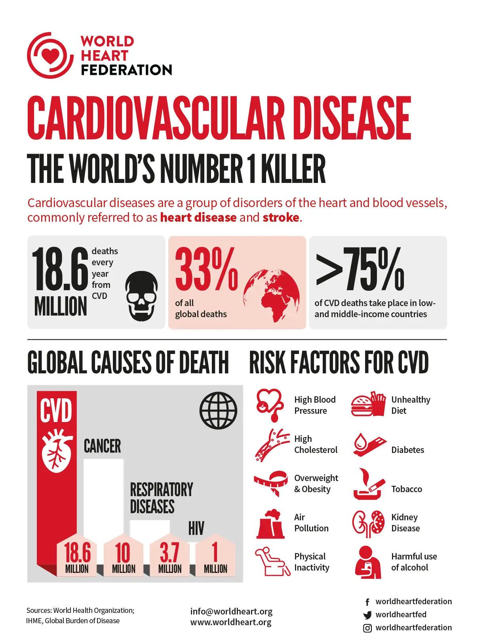
By employing cutting-edge machine learning algorithms and analyzing a diverse set of health-related data, this system aims to revolutionize preventive care and improve patient outcomes.
The primary goal of this predictive analytics system is to create a personalized heart profile and to cumulate a heart score to predict his future cardiovascular health.. By analyzing various risk factors such as age, gender, medical history, lifestyle choices, genetic predisposition, and clinical indicators, the system generates personalized risk assessments.

Slide 5
LITERATURE SURVEY
Title​ | Authors​ | Focuses on​ | Drawbacks
Fingertip based heart beat monitoring system using embedded systems, [2017] | T.S. Arulananth and B. Shilpa | It is based on the principal of Photo Phelthysmo Graphy. | Can’t be use in running or Treadmill stress test.
Backpropagation neural network for prediction of heart disease. [2013] | J. Theor | The paper uses a publicly available dataset. | The model is based on a single dataset.
Pulse Oximetry and IOT based Cardiac Monitoring Integrated Alert System. [2018] | D. Murali, D. R. Rao, S. R. Rao and M. Ananda | This technology uses a medical sensor creating a photoplethsmogram. | This paper does not provide any data to support the effectiveness and accuracy of the proposed system.
Identification of significant features and data mining techniques in predicting heart disease. [2019] | M. S. Amin, Y. K. Chiam, K. D. Varathan | ​The paper uses a dataset of 13 medical attributes and evaluates the performance of seven data mining methods | The paper does not compare its results with other existing studies on heart disease prediction.
Heart Attack Probability Analysis Using Machine Learning. [2021] | A. A. Shanbhag, C. Shetty, A. Ananth, A. S. Shetty, K. Kavanashree Nayak and B. R. Rakshitha | accuracy of prediction with highest value of accuracy as 85.7% for SVM model. | Only single SVM algorithm used in the model.

Slide 6



Problem Statement
Rise In CardioVascular Diseases
Cardiovascular diseases, including heart disease and stroke, have reached epidemic proportions, becoming the leading cause of death worldwide.
Improved Self-Diagnosis
Advance self-diagnosis capabilities for individuals concerned about their cardiovascular health.
Early Detection
The early detection not only reduce the cost but also improves the quality of life.

Slide 7
Objectives
Cost-Effectiveness
Interpretability
Automation
Security & Privacy
User-Friendly Interfaces

Slide 8
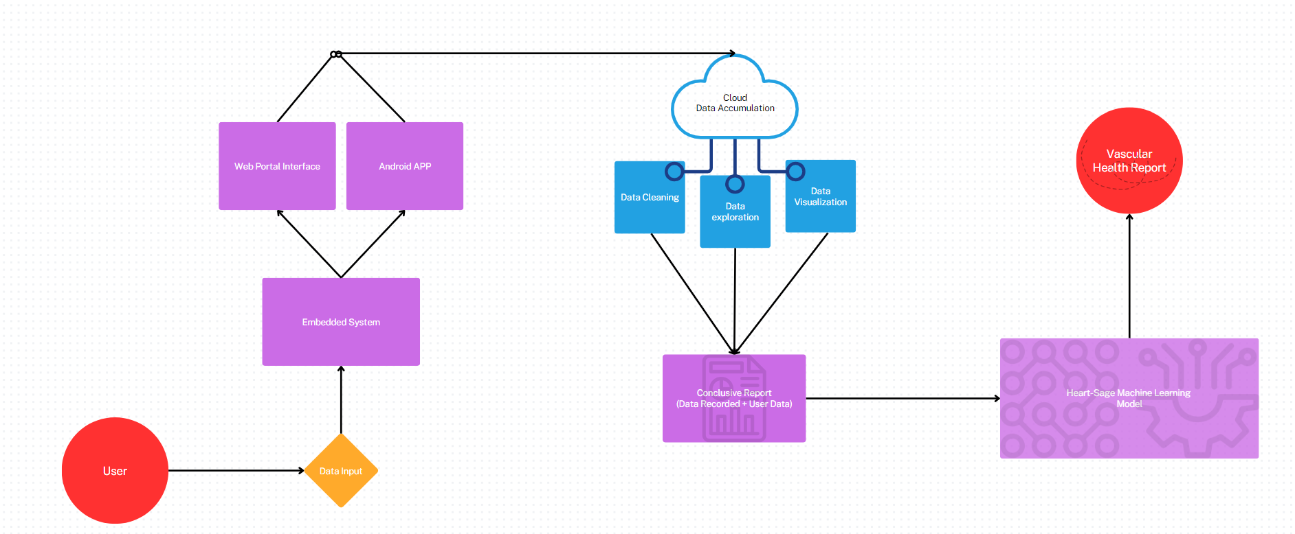
Proposed Methodology

Slide 9
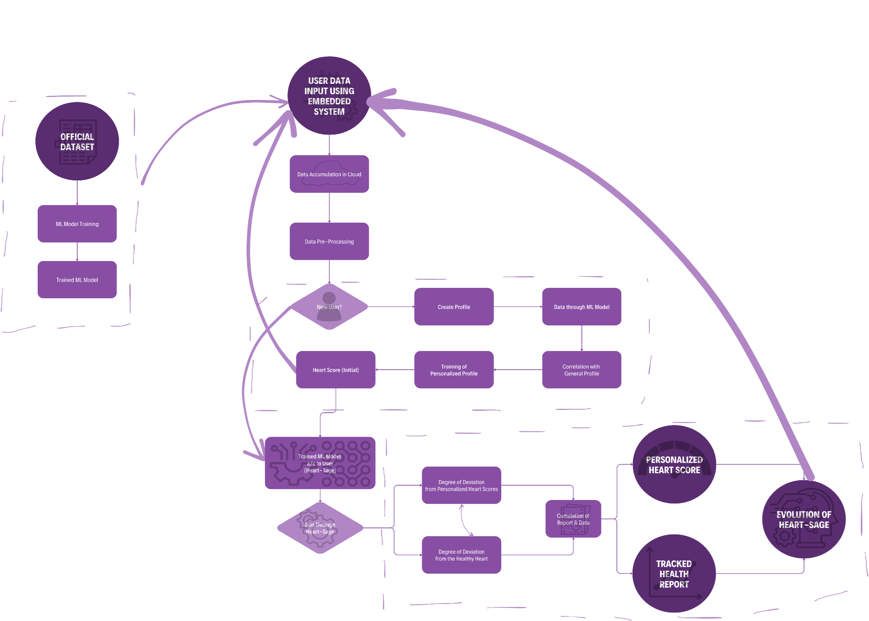
Block Diagram
https://bit.ly/46r3DF3

Slide 10
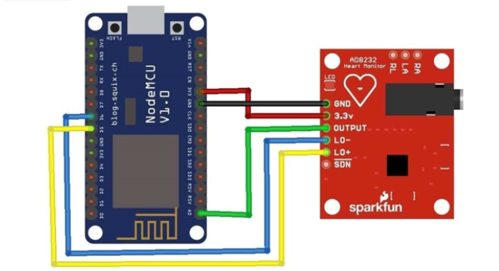
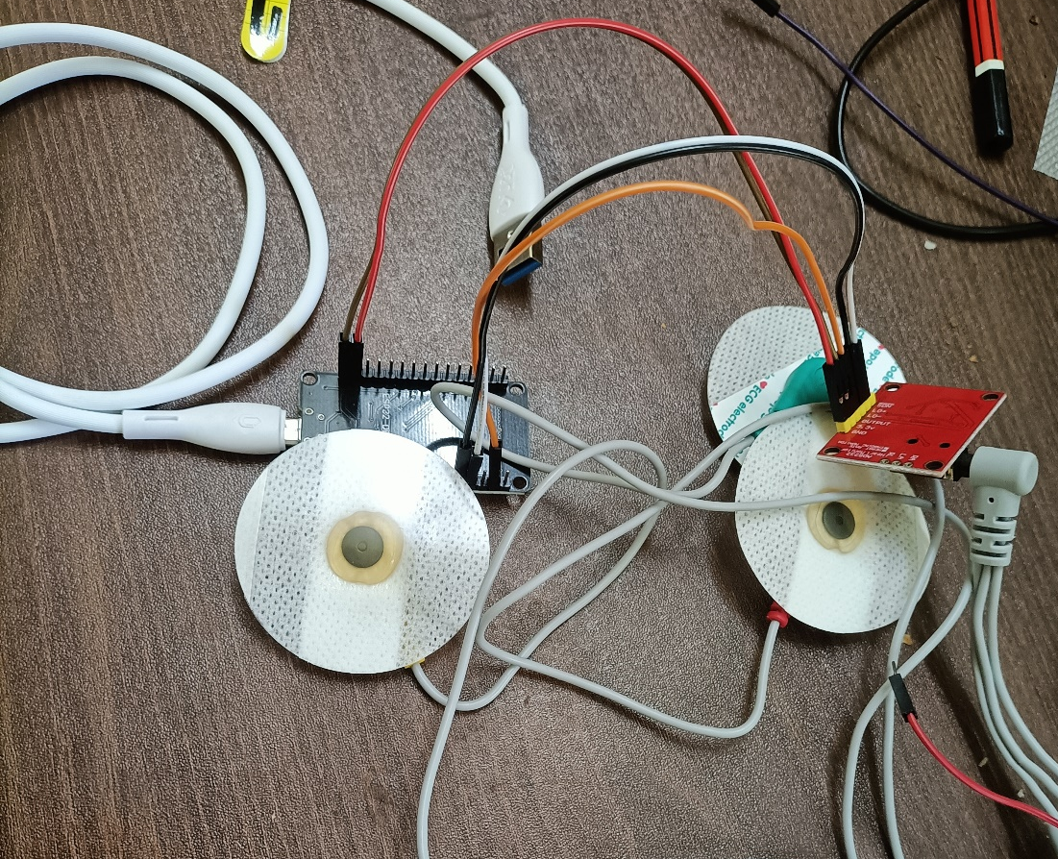
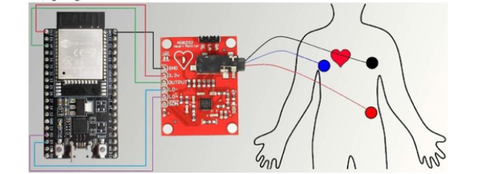
Circuit Diagram

Slide 11
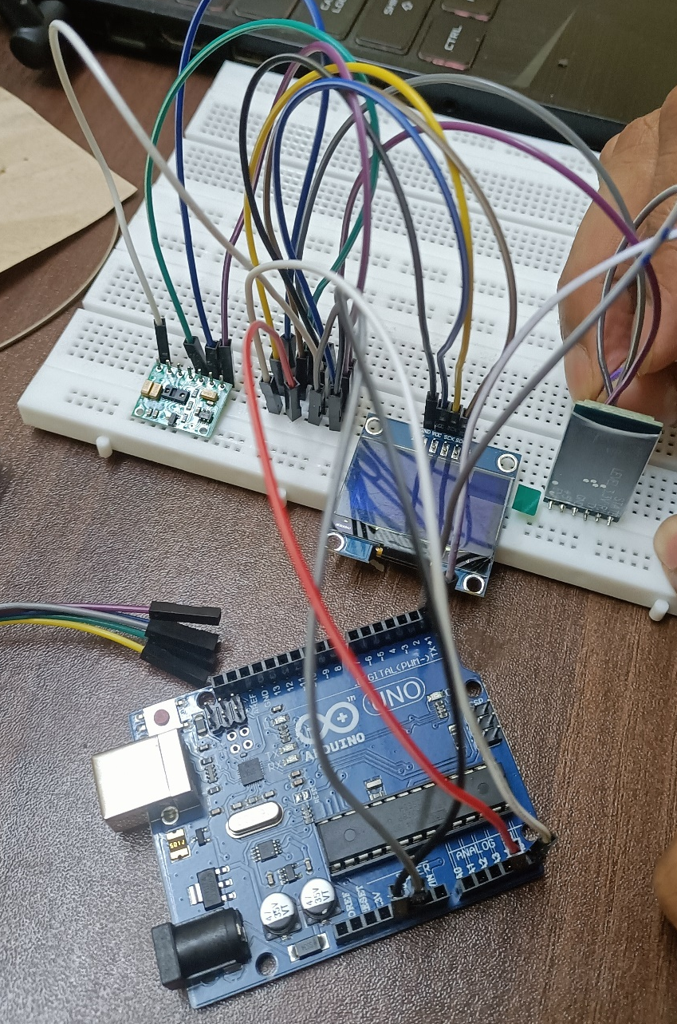
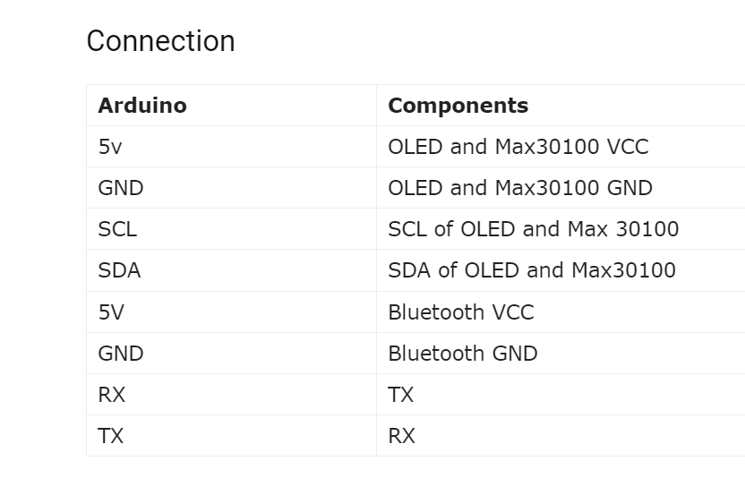
Connection

Slide 12
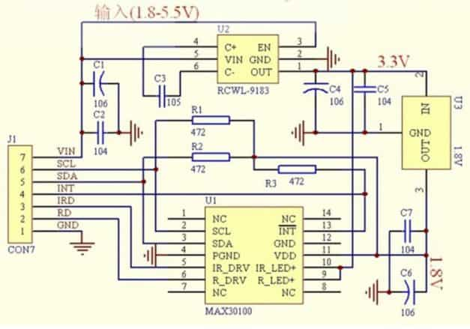
Circuit Diagram
MAX30100

Slide 13
Implementation Process
Device Deployment and Data Collection:
Deploy embedded devices to collect physiological data from patients.
Implement web portal to record user input data.
IoT Cloud Application Development:
- Developing a web and mobile application for users to interact with IoT devices and view predictions.
Implement real-time data visualization and user-friendly interfaces.
Enable users to input personal information and receive predictions.
Cloud Infrastructure Setup:
- Choose a cloud platform (e.g., AWS, Azure, Google Cloud) for data storage and processing.
- Set up cloud databases and storage for storing device data.

Slide 14
Implementation Process
Data Preparation:
- Extract meaningful features from data (e.g., heart rate variability, ECG patterns).
- Data cleaning, exploration and preprocessing features to prepare them for machine learning.
Machine Learning Model Development:
- Choose a suitable machine learning algorithms for classification.
- Train and validate the model using cross-validation techniques.
Continuous Monitoring and Model Updates:
- Setting up continuous monitoring of incoming data streams.
Regularly retraining the machine learning model to adapt to new data.
Testing and Validation:
- Conduct thorough testing of the entire system, including sensor data collection, cloud processing, and the machine learning model.
- Validate the model's predictions against known cases and clinical expertise.

Slide 15
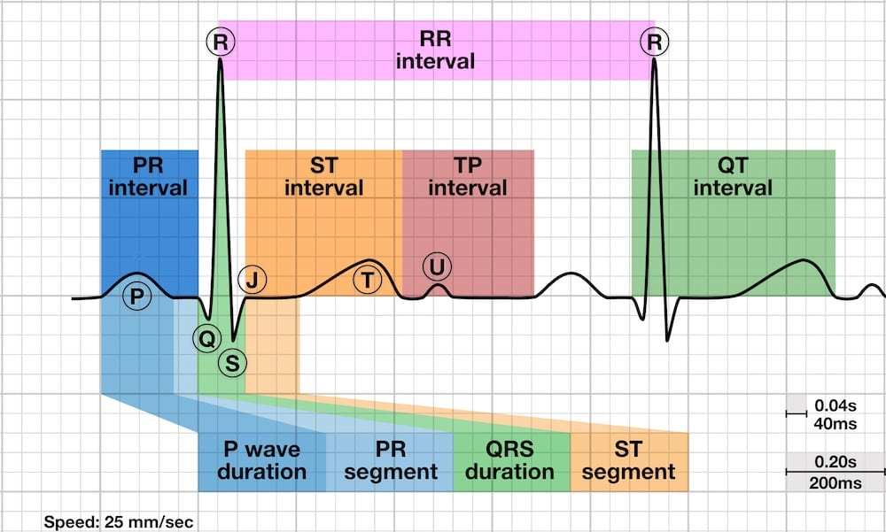
S-T Segment
The ST segment is the flat, isoelectric section of the ECG between the end of the S wave (the J point) and the beginning of the T wave.
The ST Segment represents the interval between ventricular depolarization and repolarization.
The most important cause of ST segment abnormality (elevation or depression) is myocardial ischemia or infarction.

Slide 16
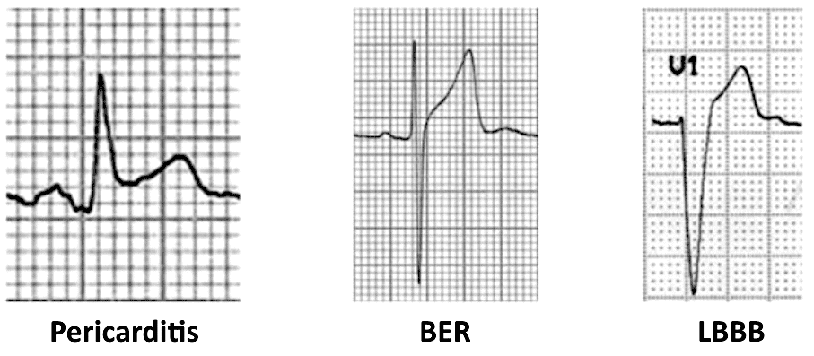
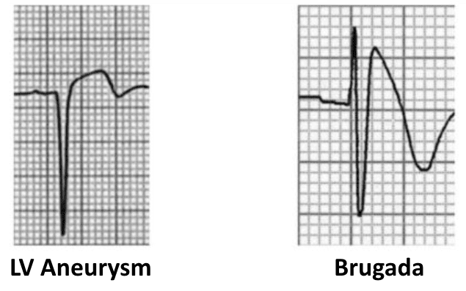
ST Segment Morphology in Other Conditions

Slide 17
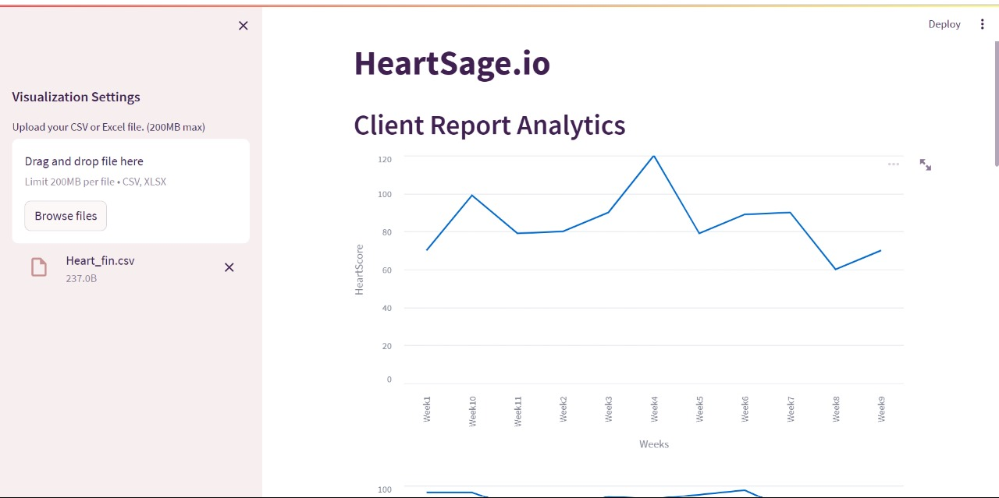
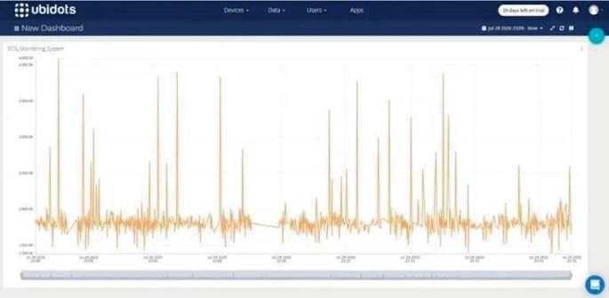
Simulation Results

Slide 18
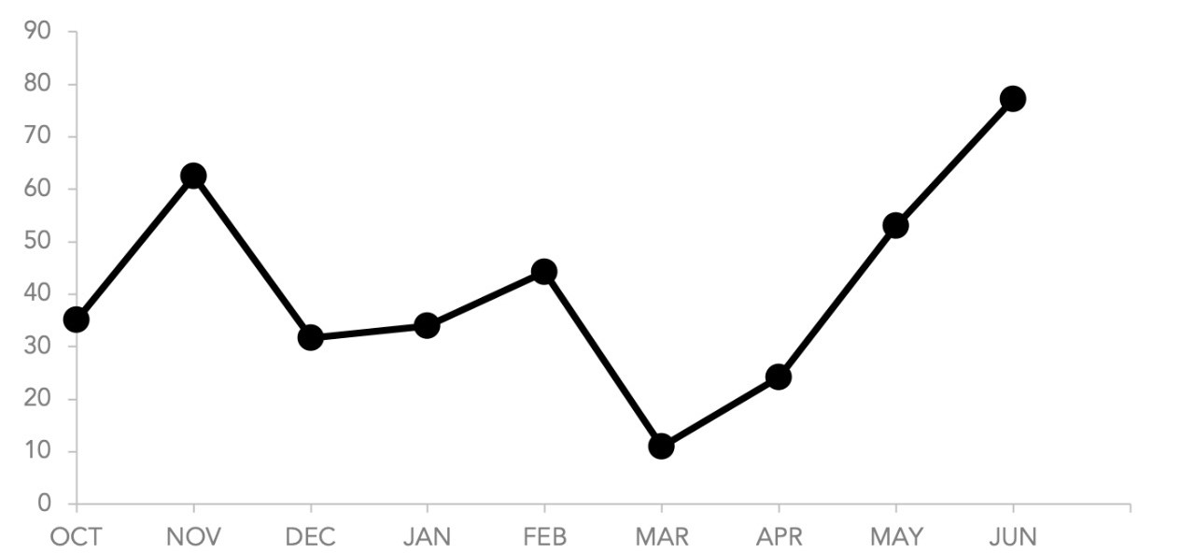
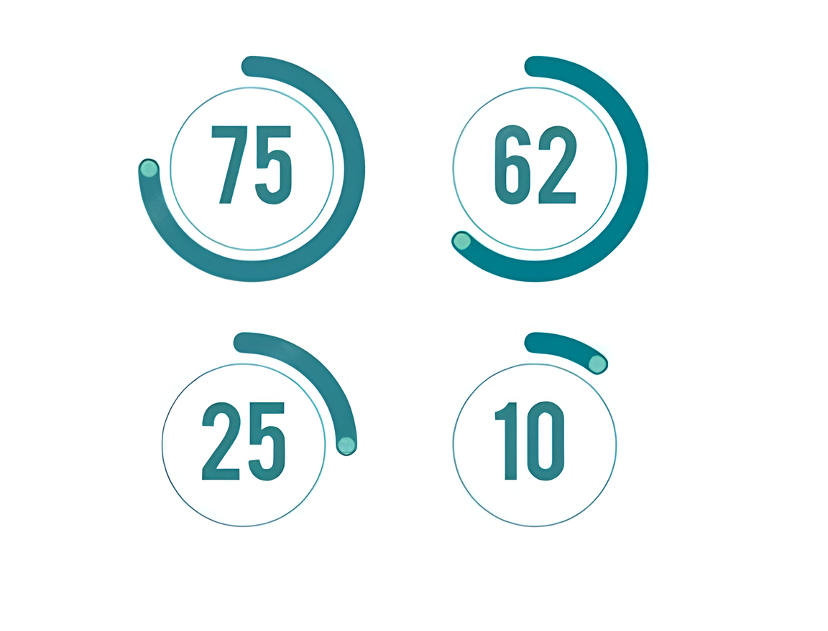
Expected Results
The above graph shows the past health score records of the person
This is a cumulative heart score that is calculated by considering several parameters

Slide 19

Advantages
Early Detection and Prevention:
The system helps in identifying individuals at high risk of a cardiovascular issue, enabling timely interventions and lifestyle changes to reduce that risk.
2. Improved Patient Outcomes:
Early intervention can significantly improve patient outcomes by reducing the severity of cardiovascular related issues and associated complications.
3 Cost-Effectiveness:
Predicting and preventing cardiovascular in advance can lead to significant cost savings for both individuals and the healthcare system by minimizing emergency care and hospitalization costs.

Slide 20


4. Personalized Medicine:
The system allows for a personalized approach to healthcare, tailoring recommendations and treatments based on an individual's specific risk factors.
5. Public Health Impact:
By identifying high-risk groups, public health initiatives can be targeted more effectively, potentially leading to a reduction in overall cardiovascular health issues in the population.
6. Data-Driven Decision Making:
Healthcare providers can make informed decisions based on the predictive insights provided by the system, enhancing the efficiency and effectiveness of their care delivery.

Slide 21
Applications
A cardiovascular health management system is a valuable tool that utilizes various algorithms, data analysis techniques, and medical information to predict the risk of an individual experiencing a heart attack. Some of its applications include:
Personalized Healthcare Plans:
Heart attack prediction systems can aid in creating personalized healthcare plans for individuals based on their risk levels.
Preventive Health Screenings:
Health institutions can use these systems to identify high-risk groups within the population for targeted preventive health screenings.
3. Health Insurance Assessment:
Health insurance companies can utilize these systems to assess the risk of potential policyholders, leading to more accurate risk assessment and appropriate premium adjustments.

Slide 22
Flowline
MONTH | WORK FLOW
NOV-DEC | Embedded system design and App Development.
JAN-FEB | Cloud Integration with Data Analysis and Transformation.
MAR-APR | Training and Implementation of ML model.
MAY | Test runs, Comparison and Deploying Heart score and dashboards on app.
JUNE | Final presentation

Slide 23
References
V. Sharma, S. Yadav and M. Gupta, "Heart Disease Prediction using Machine Learning Techniques," 2020 2nd International Conference on Advances in Computing, Communication Control and Networking (ICACCCN).
J. S. Rose, P. Malin Bruntha, S. Selvadass, R. M. V, B. C. Mary M and M. J. D, "Heart Attack Prediction using Machine Learning Techniques," 2023 9th International Conference on Advanced Computing and Communication Systems (ICACCS).
M. Neyja, S. Mumtaz, K. M. S. Huq, S. A. Busari, J. Rodriguez and Z. Zhou, "An IoT-Based E-Health Monitoring System Using ECG Signal," GLOBECOM 2017 - 2017 IEEE Global Communications Conference.
O. Y. Tham, M. A. Markom, A. H. A. Bakar, E. S. M. M. Tan and A. M. Markom, "IoT Health Monitoring Device of Oxygen Saturation (SpO2) and Heart Rate Level," 2020 1st International Conference on Information Technology, Advanced Mechanical and Electrical Engineering (ICITAMEE).

Slide 24


